Slide 1
UNIT–II Data Link Layer &MAC Sublayer:
Syllabus:Need, Services Provided, Design issues, Elementary datalink
protocols: simplex protocol, A simplex stop and wait protocol for an error-free channel, A simplex stopand wait protocol for noisy channel. Sliding Window protocols: A one-bit sliding window protocol, A
protocol using Go-Back-N, A protocol using Selective Repeat, MAC Addressing, Binary ExponentialBack-off (BEB) Algorithm, Distributed Random Access Schemes/Contention Schemes: for Data
Services (ALOHA and Slotted- ALOHA), CSMA, CSMA/CA, CSMA/CD.

Slide 2
FLOW AND ERROR CONTROL
The most important responsibilities of the data link layer are flow control and error control. Collectively, these functions are known as data link control.

Slide 3
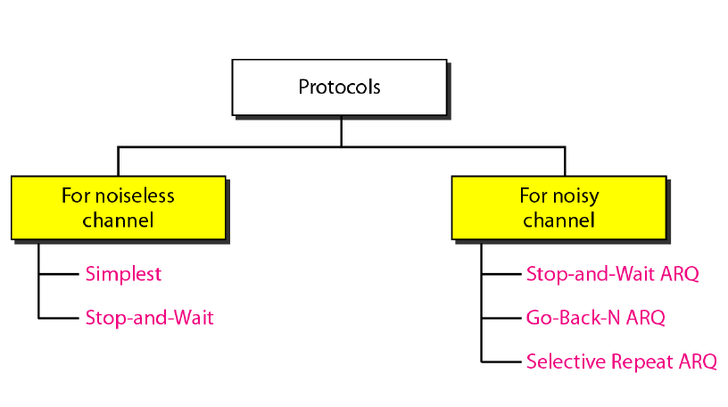
classification of protocols

Slide 4
NOISELESS CHANNELS
we have an ideal channel in which no frames are lost, duplicated, or corrupted. We introduce two protocols for this type of channel.
Simplest Protocol – has no flow or error control
Stop-and-Wait Protocol – sender sends one frame, stops until it receives agree from receiver and then sends the next frame

Slide 5
Simplest Protocol
Our first protocol, which we call the Simplest Protocol, is one that has no flow or error control. Like other protocols, it is a unidirectional protocol in which data frames are traveling in only one direction-from the sender to receiver.
The receiver can immediately handle any frame it receives with a processing time that is small enough to be negligible.
The data link layer of the receiver immediately removes the header from the frame and hands the data packet to network layer, which can also accept the packet immediately.
In other words, the receiver can never be fill out with incoming frames.

Slide 6
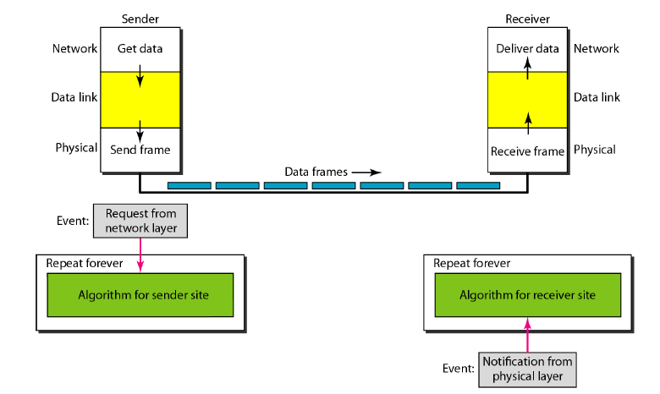
The design of the simplest protocol with no flow or error control

Slide 7
Stop-and-Wait Protocol
If data frames arrive at the receiver site faster than they can be processed, the frames must be stored until their use. Normally, the receiver does not have enough storage space, especially if it is receiving data from many sources.
We need to tell the sender to slow down. There must be feedback from the receiver to the sender.
The sender sends one frame, stops until it receives agreement the receiver (okay to go ahead), and then sends the next frame. We still have unidirectional communication for data frames, but auxiliary ACK frames (simple tokens of acknowledgment) travel from the other direction. We add flow control to our previous protocol.

Slide 8
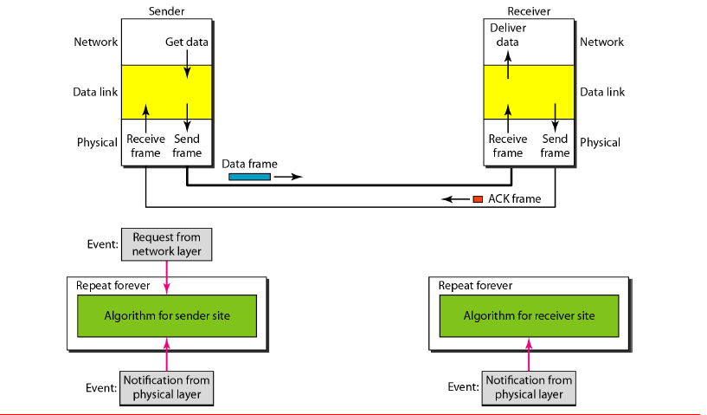
Design of Stop-and-Wait Protocol

Slide 9
NOISY CHANNELS
Although the Stop-and-Wait Protocol gives us an idea of how to add flow control to its predecessor, noiseless channels are nonexistent. We discuss three protocols in this section that use error control.

Slide 10
Flow Control
When the sender is running on fast machine or lightly loaded machine and receiver is on slow or heavily loaded machine. Then the transmitter will transmit frames faster than the receiver can accept them.
Even if the transmission is error free at a certain point the receiver will simply not be able to handle the frames as they arrive and will start to lose some.
To prevent this, flow control mechanism is incorporated which includes a feedback mechanism requesting transmitter a retransmission of incorrect message block.
The most common retransmission technique is known as Automatic –Repeat-Request (ARQ).

Slide 11
Error Control
To ensure the proper sequencing and safe delivery of frames at the destination, an acknowledgement should be sent by the destination network.
If the sender receives a positive acknowledgement (ack) it means the frame has arrived safely.
If a negative acknowledgement (nak) arrives that means, something has gone wrong and the frame is to be retransmitted.
A timer at sender’s and receiver’s end is introduced. Also sequence numbers to the outgoing frames are maintained so that the receiver can distinguish retransmissions from originals. This is one of the most important part of data link layer.

Slide 12
Error Control in Data Link Layer (DLL) is based on Automatic-Repeat-Request (ARQ) i.e. retransmission of data in three cases.
Damaged frames
ii) Lost frames
iii) Lost acknowledgements

Slide 13
Steps in ARQ
An ARQ protocol is characterized by four functional steps:
Transmission of frames
ii) Error checking at the receiver end
iii) Acknowledgement
a) Negative, if error is detected (NAK)
b) Positive, if no error is detected (ACK)
Retransmission if acknowledgment is negative or if no
acknowledgement is received within a predefine time.

Slide 14
ARQ Techniques
ARQ Techniques
Stop-and-wait ARQ
Sliding Window ARQ
Go-Back-N
Selective Repeat

Slide 15
Stop-and-Wait ARQ
Stop-and-wait ARQ is the simplest mechanism for error control and flow control.
Operation
The sender transmits the frame, when frame arrives at receiver it checks for damage and acknowledges to the sender accordingly.
While transmitting a frame there can be four situations:
a) Normal Operation
b) The Frame is lost.
c) The acknowledgement is lost.
d) The acknowledgement is delayed.

Slide 16
a) Normal Operation
In normal operation the sender sends frame 0 and waits for acknowledgement ACK 1.
After receiving ACK 1, sender sends next frame 1 and waits for its acknowledgement ACK 0. This operation is repeated.
Usually a timer is set by sender after each frame is transmitted, its acknowledgement must be received before timer expires.

Slide 17
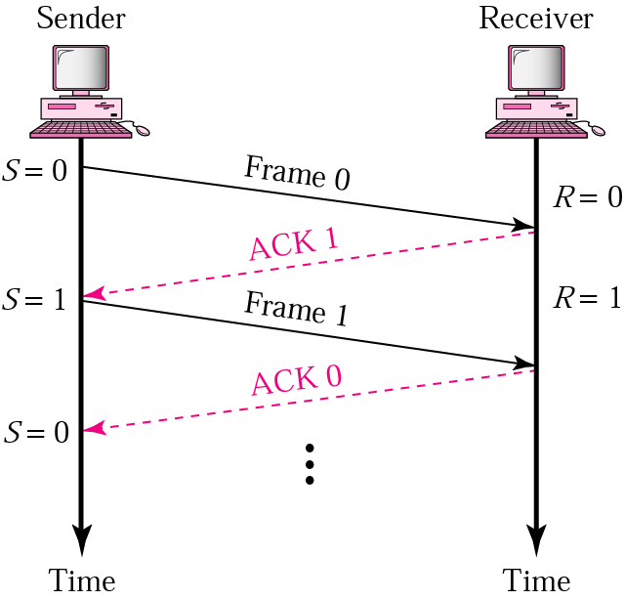
Normal Operation

Slide 18
b) Lost or Damaged Frame
When a receiver receives the frame and found it damaged or lost, it is discarded but retains its number.
When sender does not receive its acknowledgement it retransmits the same frame.

Slide 19
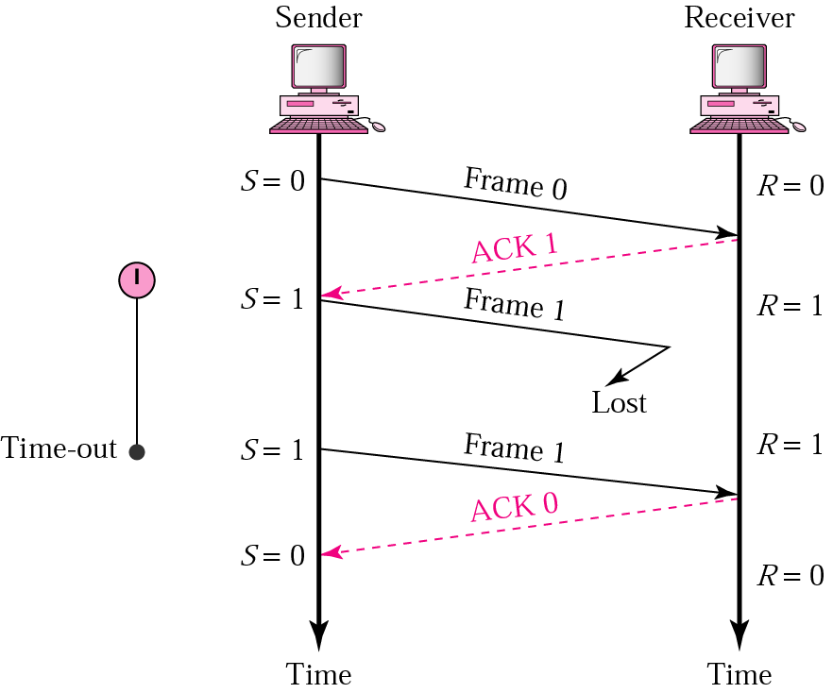
Stop-and-Wait ARQ, Lost Frame

Slide 20
c) Lost Acknowledgement
When an acknowledgement is lost, the sender does not know whether the frame is received by receiver or not.
After the timer expires, the sender re-transmits the same frame. On the other hand, receiver has already received this frame earlier hence the second copy of the frame is discarded.

Slide 21
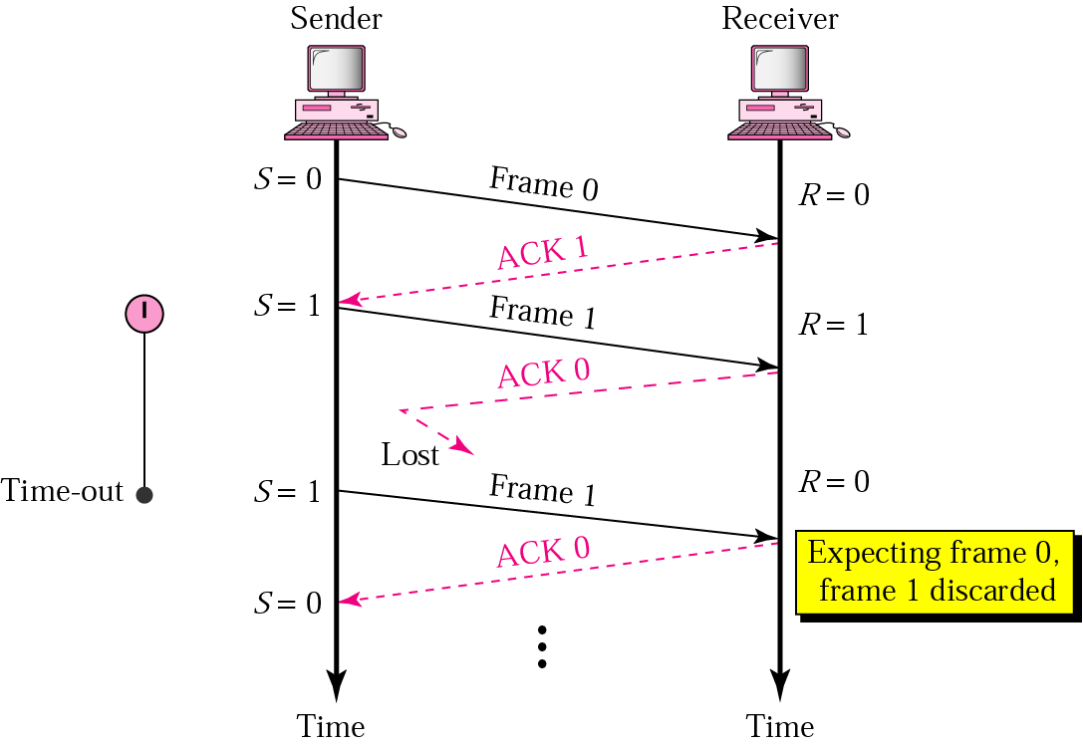
Stop-and-Wait ARQ, Lost ACK Frame

Slide 22
d) Delayed Acknowledgement
The ACK frame may be delayed due to some link problem. The ACK is received after the timer is elapsed. While the sender has already transmitted the same frame.
Again second ACK is initiated by receiver for the retransmitted frame, hence the second ACK is discarded.
To avoid duplication the ACKs must be numbered.

Slide 23
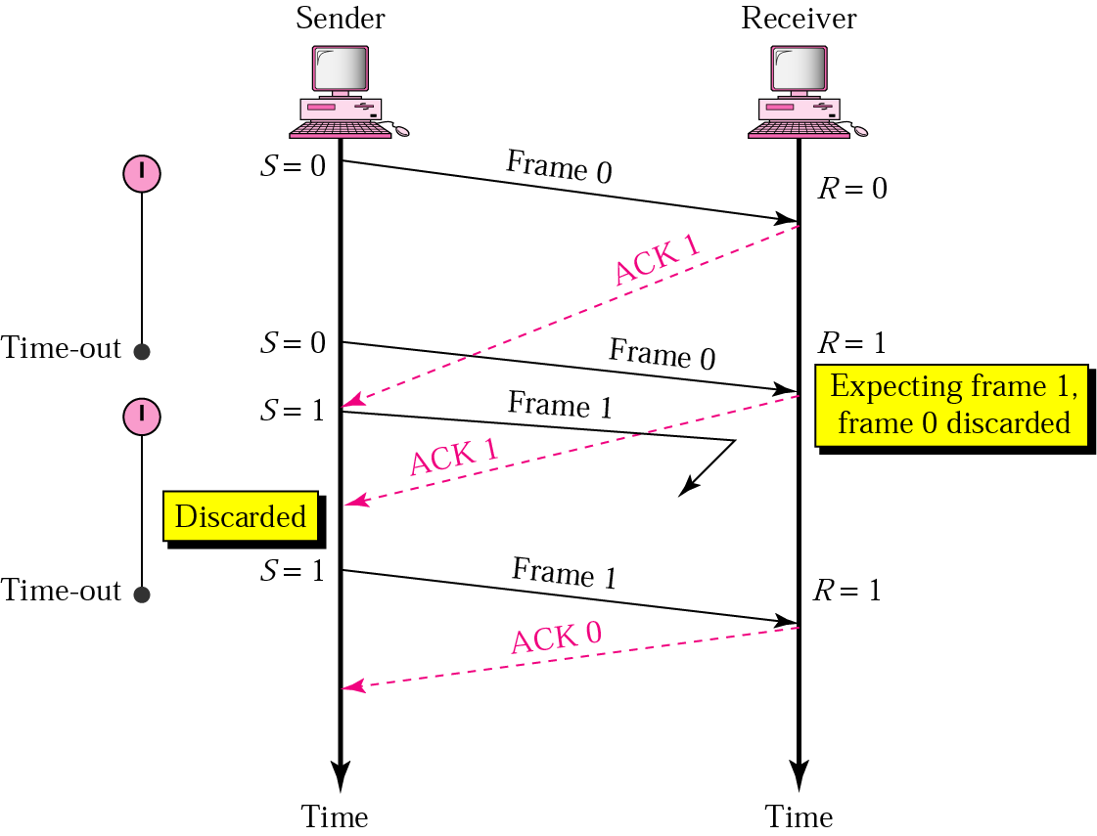
Stop-and-Wait ARQ, Delayed ACK

Slide 24
Features of Stop-and-Wait ARQ
Sender keeps a copy of last transmitted frame until its ACK is received.
Both data frame and ACK frame are alternately numbered as 0 and 1 for identification of frame and to avoid duplication of frames.
The sender maintains a timer, if ACK is not received in time, sender assumes it lost.

Slide 25
Sliding Window Protocol
In Sliding window protocol multiple data frames can be transmitted continuously without waiting for acknowledgements of individual data frames.
The transmitting station maintains a sending window that describes the number of messages with their sequence numbers.
The receiving station maintains a receiving window that performs complementary functions.
Each data frame carries a sequence number for its identification.
The number of frames in a window is called its size.
A copy of each transmitted frame is retained in the window till it is acknowledged.

Slide 26
Sequencing of Frames
All data frames are given a sequence number, which is a binary number of a fixed number of bits.
If there are n bits, the length of the count sequence would be 2^{n}.
The two-bit numbering scheme counts from 0 to 3 and then again starts from 0.
No sequence number must be repeated within the window.

Slide 27
Go-Back-N
As in Stop-and-wait protocol senders has to wait for every ACK then next frame is transmitted. But in Go-Back-N ARQ W frames can be transmitted without waiting for ACK.
Sequence Number: Sequence numbers of transmitted frame are maintained in the header of each frame. If k is the number of bits for sequence number, then the numbering can range from 0 to 2^{k}-1. for e.g. if k=3 then sequence numbers are 2³-1= 0 to 7.

Slide 28
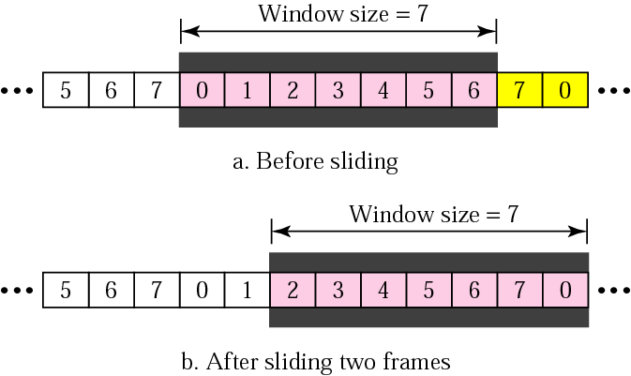
Sender Sliding Window
This window keeps on sliding in forward direction.
The window size is fixed.
As the frame sent, the respective frame goes out of window and new frame to sent come into window.

Slide 29
Receiver Sliding Window
In the receiver side the size of the window is always one.
The receiver is expecting to arrive frames in specific sequence.
Any other frame received which is out of order is discarded.
The receiver slides over after receiving the expected frame.
The receiver responds for frames arriving safely by positive acknowledgement. For damaged or lost frames receiver does not reply, the sender has to retransmit it when timer of that frame elapsed.

Slide 30
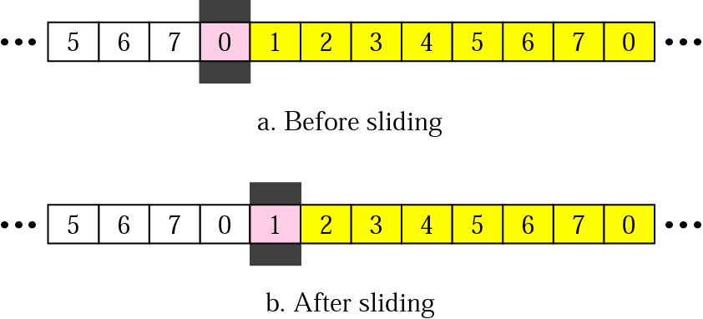
Receiver Sliding Window

Slide 31
Control Variables
a) Sender Variables:
The sender deals with three different variables
S→ sequence number of recently sent frame.
S_{F}→ sequence number of first frame in window.
S_{L}→ sequence number of last frame in window.
Window size W= S_{L} – S_{F} +1
b) Receiver Variable:
The receiver deals with one variable only.
R→ sequence number of frame expected.
If the number matches, then the frame is accepted otherwise not.

Slide 32
Operation
a) Normal Operation:
The sender sends frames and update the control variables i.e. S_{F}, S, S_{L} and receiver update variable R.
b) Damaged or Lost Frame:
Suppose frame 2 is damaged or lost and if receiver receives frame 3, it will be discarded since it is expecting frame 2. Sender retransmits frame 2 and frame 3.

Slide 33
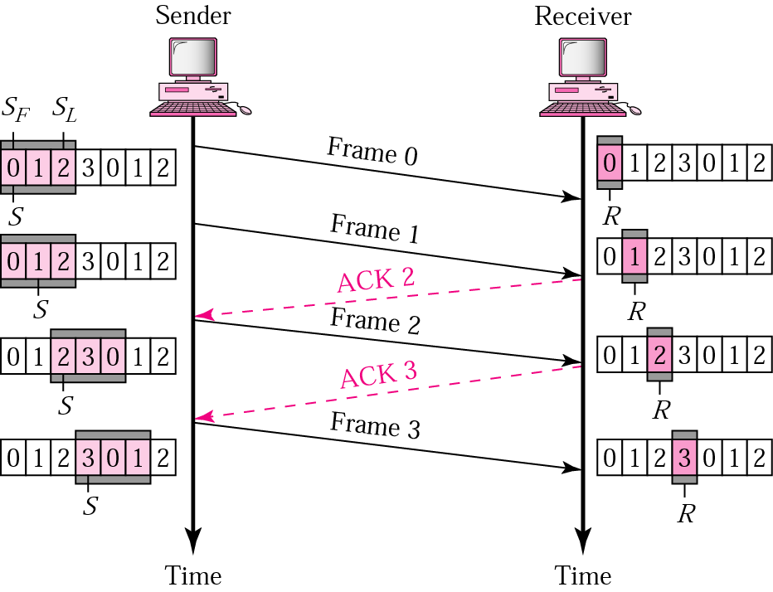
Go-Back-N ARQ, Normal Operation

Slide 34
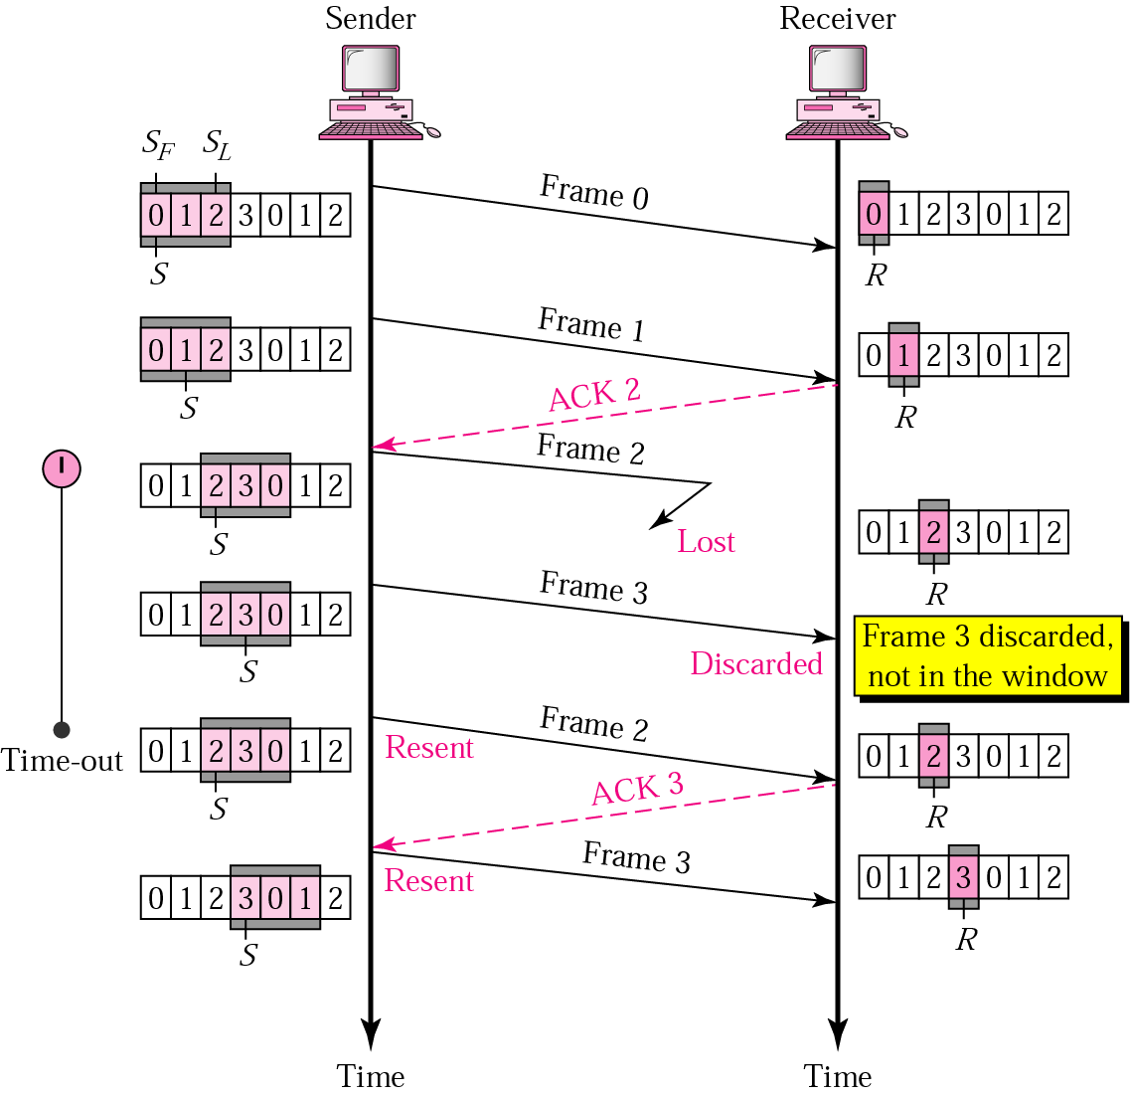
Go-Back-N ARQ, Lost or Damaged Frame

Slide 35
Selective Repeat
Selective repeat ARQ retransmits only the damaged or lost frames instead of sending multiple frames.
The selective retransmission increases the efficiency of transmission and is more suitable for noisy channel.
The size of sender window is one half of 2^{k}. The receiver window size is of same length as that of sender.
The boundaries of receiver window are defined by R_{F} and R_{L.}
Negative acknowledgement (NAK) is used for lost or damaged frames.

Slide 36
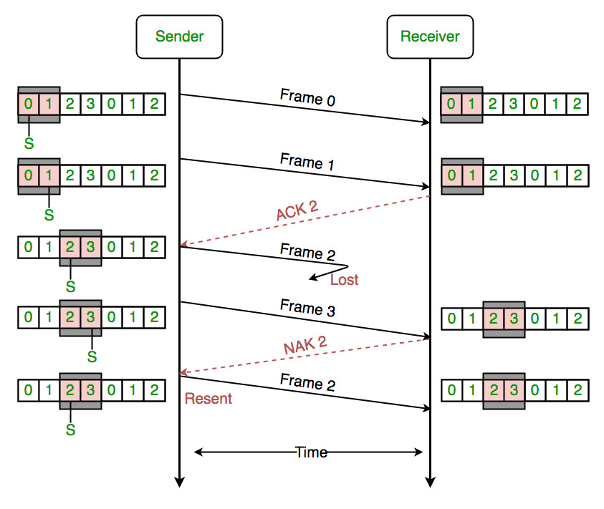
Selective Repeat ARQ

Slide 37
Piggybacking
The most important responsibilities of the data link layer are flow control and error control. Collectively, these functions are known as data link control.
All the protocol we discussed in data link are unidirectional . That is data frame travel from sender to receiver and ACK from receiver to sender.
In real life data link protocol are implemented as bidirectional.
In these protocol flow and error control information such as ACK/NAK is combined with data frame, this technique is called piggybacking

Slide 38
Piggybacking
Three rules govern the piggybacking data transfer, Whenever station A wants to send data to station B:
If station A wants to send both data and an acknowledgment, it keeps both fields there.
If station A wants to send just the acknowledgment, then a separate ACK frame is sent.
If station A wants to send just the data, then the last acknowledgment field is sent along with the data. Station B simply ignores this duplicate ACK frame upon receiving.

Slide 39
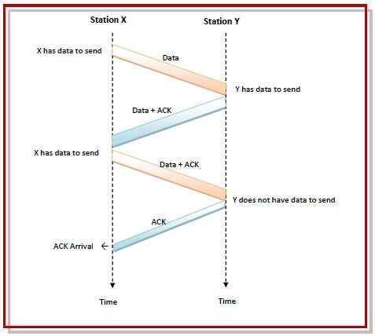

Slide 40
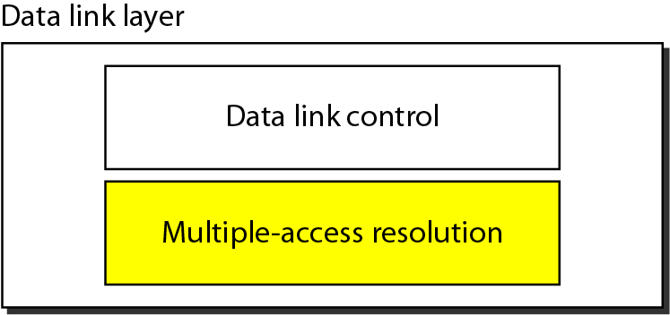
Data link layer divided into two functionality-oriented sublayers
Responsible for error and flow control
LLC
Control
MAC
Responsible for framing, MAC address and Multiple Access Control

Slide 41
Introduction
The medium access sublayer is the bottom part of data link layer.
The media access control mechanism standardized by IEEE are implemented in the MAC sublayer of the data link layer.
It provides service to the LLC sublayer and receives service from the physical layer below it.

Slide 42
Approaches to Access a Transmission Medium
Media
Static Allocation
Dynamic Allocation
Scheduling
Random access

Slide 43
Static Channel Allocation
In LAN, number of work stations are operating and only one user is allowed to broadcast on the channel.
One way of allocating a single channel among multiple competing users is by using FDM.
For N number of users, the bandwidth is divided into N equal portions, each user being assigned one portion.

Slide 44
Dynamic Channel Allocation
Dynamic channel allocation method is incorporated in all LANs and WANs.
Dynamic channel allocation method can handle all types of traffic condition.
A discipline is built up among the stations of the LAN. So that, fair opportunity is given to each station to transmit its data frames.

Slide 45
Multiple Access
Problem: When two or more nodes transmit at the same time, their frames will collide and the link bandwidth is wasted during collision.
How to coordinate the access of multiple sending/receiving nodes to the shared link?
Solution: We need a protocol to coordinate the transmission of the active nodes.
These protocols are called Medium or Multiple Access Control (MAC) Protocols belong to a sublayer of the data link layer called MAC (Medium Access Control)
What is expected from Multiple Access Protocols:
Main task is to minimize collisions in order to utilize the bandwidth by:
Determining when a station can use the link (medium)
what a station should do when the link is busy
what the station should do when it is involved in collision

Slide 46
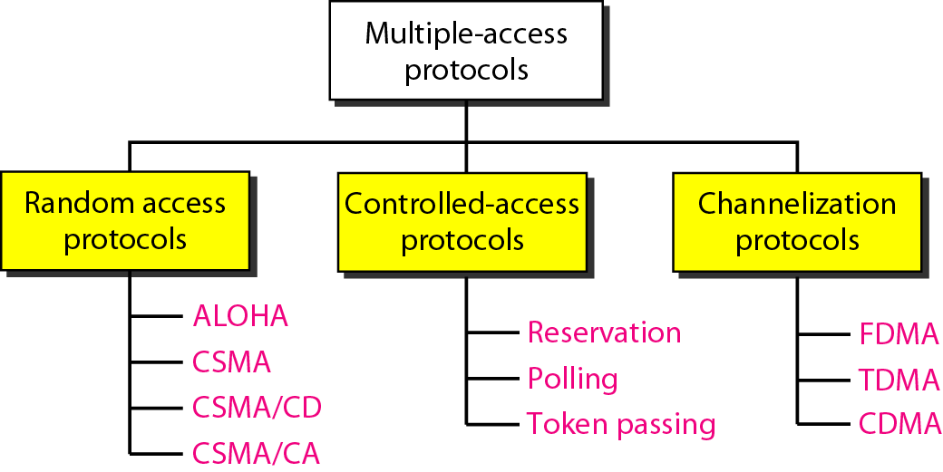
Multiple-Access Protocols
For wireless

Slide 47
Random Access
Random Access Protocols:
No station is superior to another station and none is assigned the control over another.
A station with a frame to be transmitted can use the link directly based on a procedure defined by the protocol to make a decision on whether or not to send.
ALOHA
Was designed for wireless LAN and can be used for any shared medium

Slide 48
Pure ALOHA
The original ALOHA protocol is called pure ALOHA.
All frames from any station are of fixed length (L bits)
A station that has data can transmit at any time.
After transmitting a frame, the sender waits for an acknowledgment for an amount of time (time out) equal to the maximum round-trip propagation delay = 2* t_{prop}
If no ACK was received, sender assumes that the frame or ACK has been destroyed and resends that frame after it waits for a random amount of time. This time is called as back-off time (T_{B}).
If station fails to receive an ACK after repeated transmissions, it gives up.
Channel utilization or efficiency or Throughput is the percentage of the transmitted frames that arrive successfully (without collisions) or the percentage of the channel bandwidth that will be used for transmitting frames without collisions
ALOHA Maximum channel utilization is 18% (i.e, if the system produces F frames/s, then 0.18 * F frames will arrive successfully on average without the need of retransmission).

Slide 49

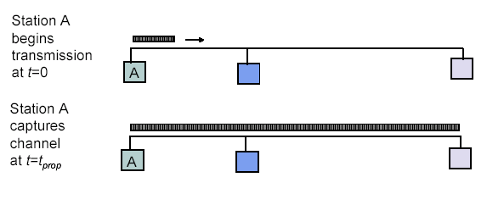
Maximum Propagation Delay
Maximum propagation delay(t_{prop}): time it takes for a bit of a frame to travel between the two most widely separated stations.
Station B
Station B receives the first bit of the frame at time t= t_{prop}

Slide 50
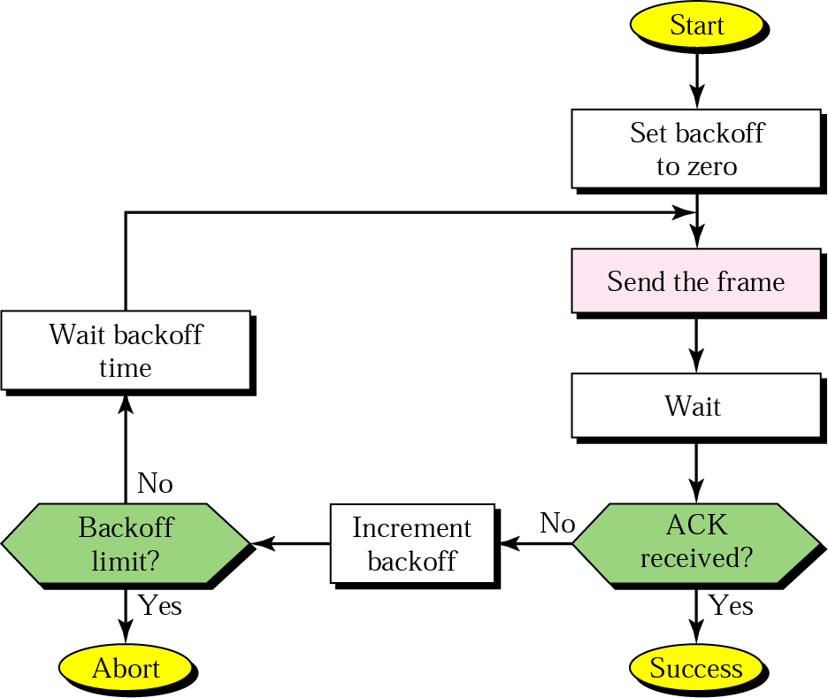
Procedure for ALOHA Protocol

Slide 51
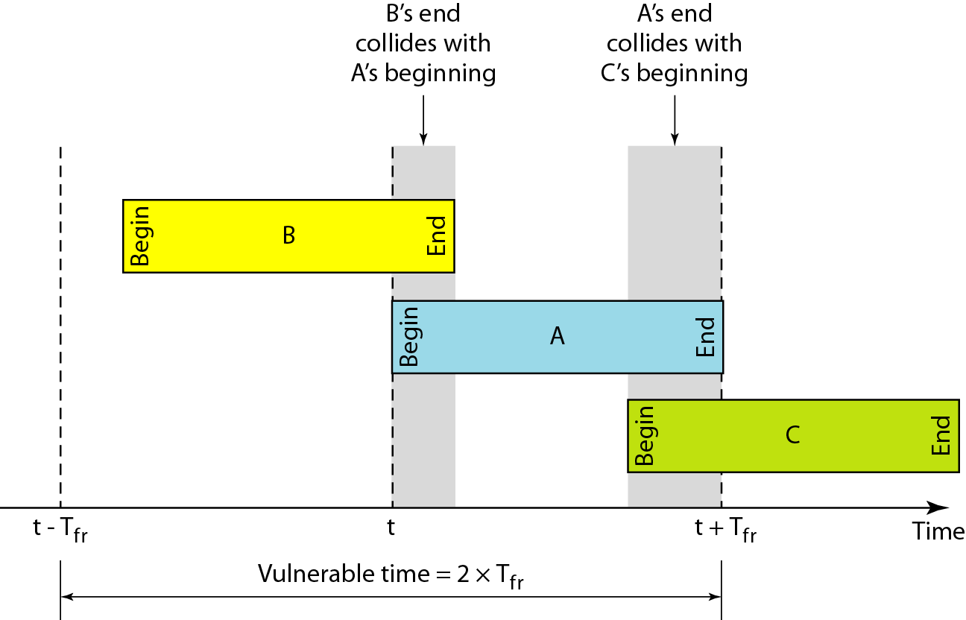
Vulnerable Time for Pure ALOHA Protocol
T_{fr}= Frame Transmission time
If the frame transmission time is T sec, then the
vulnerable time is = 2 T sec.
This means no station should send during the T-sec before this station starts transmission and no station should start sending during the T-sec period that the current station is sending.

Slide 52
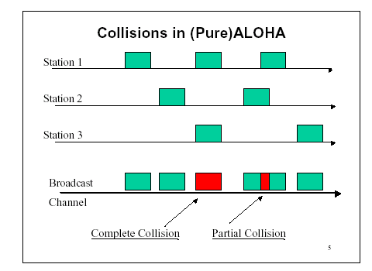
Pure ALOHA
In pure ALOHA, frames are transmitted at completely arbitrary times.

Slide 53
Advantage of ALOHA protocols
A node that has frames to be transmitted can transmit continuously at the full rate of channel (R bps) if it is the only node with frames.
Simple to be implemented.
No master station is needed to control the medium
Disadvantage
If (M) nodes want to transmit, many collisions can occur and the rate allocated for each node will not be an average R/M bps
This causes low channel utilization

Slide 54
CSMA
The low maximum throughput of the ALOHA schemes is due to the wastage of transmission bandwidth because of frame collision.
This wastage can be reduced by avoiding transmissions that are certain to cause collision.
By sensing the medium for the presence of a carrier signal from other stations, a station can determine whether there is an ongoing transmission.
CSMA requires that each station first listen to the medium before sending.
CSMA can reduce the possibility of collision, but it cannot eliminate it.

Slide 55
Vulnerable Time for CSMA
The vulnerable time for CSMA is the propagation time (T_{p}).
This is the time needed for a signal to propagate from one end of the medium to the other.

Slide 56
Types of CSMA Protocols
Different CSMA protocols that determine:
What a station should do when the medium is idle?
What a station should do when the medium is busy?
Non-Persistent CSMA
1-Persistent CSMA
P-Persistent CSMA

Slide 57
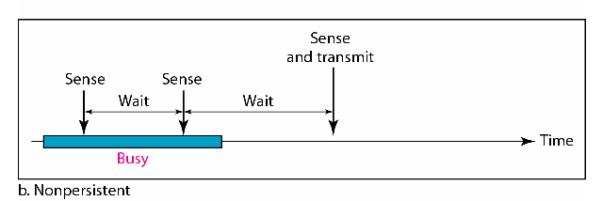
Nonpersistent CSMA
A station with frames to be sent, should sense the medium
If medium is idle, transmit; otherwise, go to 2
If medium is busy, (backoff) wait a random amount of time and repeat 1
Non-persistent Stations are deferential (respect others)
Performance:
Random delays reduces probability of collisions because two stations with data to be transmitted will wait for different amount of times.
Bandwidth is wasted if waiting time (backoff) is large because medium will remain idle following end of transmission even if one or more stations have frames to send
Random Waiting times
Wasted time

Slide 58
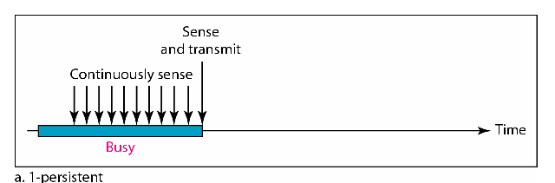
1-Persistent CSMA
To avoid idle channel time, 1-persistent protocol used
Station wishing to transmit listens to the medium:
If medium idle, transmit immediately;
If medium busy, continuously listen until medium becomes idle; then transmit immediately with probability 1
Performance
1-persistent stations are selfish
If two or more stations becomes ready at the same time, collision guaranteed

Slide 59
P-Persistence CSMA
To reduce the probability of collision in 1-persistent CSMA, not all the waiting stations are allowed to transmit immediately, after the channel is idle.
When a station becomes ready to send and it senses the channel to be idle, it either transmits with a probability p or it defers transmission by one time slot with a probability q=1-p.
If the deferred slot is also idle, the station either transmits with probability p or defers again with a probability q.
This process is repeated until either packets are transmitted or the channel becomes busy.

Slide 60
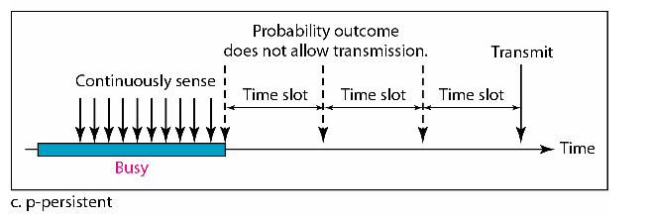
P-persistent CSMA
Time is divided to slots where each Time unit (slot) typically equals maximum propagation delay
Station wishing to transmit listens to the medium:
If medium idle,
transmit with probability (p), OR
wait one time unit (slot) with probability (1 – p), then repeat 1.
If medium busy, continuously listen until idle and repeat step 1
Performance
Reduces the possibility of collisions like nonpersistent
Reduces channel idle time like 1-persistent

Slide 61
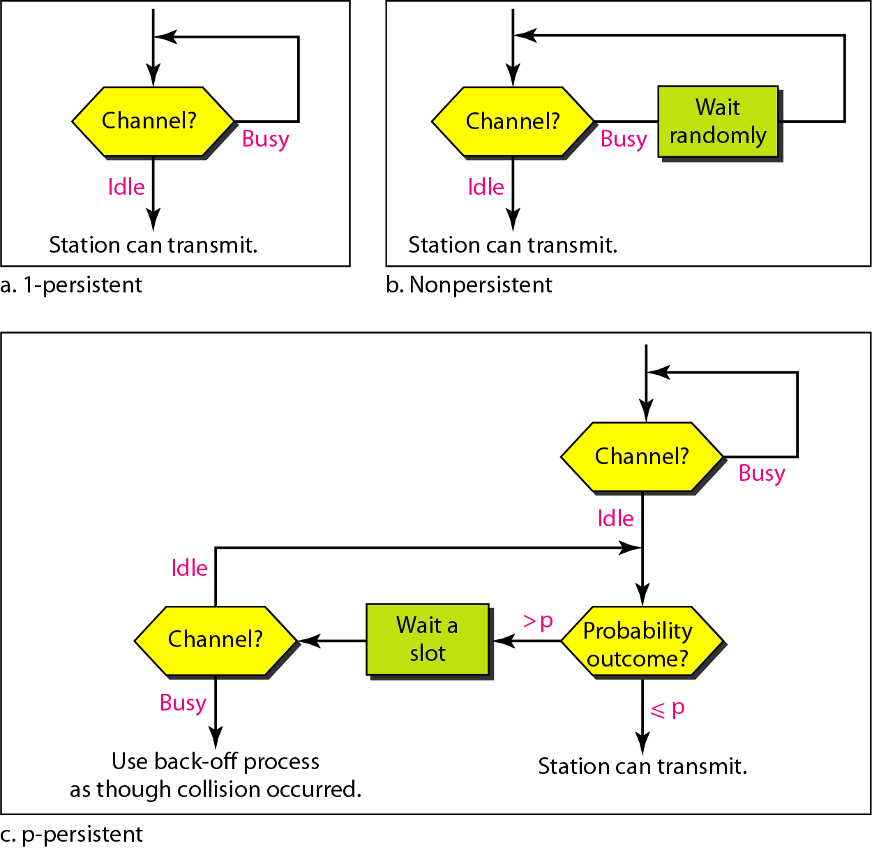
Flow diagram for three persistence methods

Slide 62
CSMA/CD
In both CSMA and ALOHA schemes, collisions involve entire frame transmissions.
If a station can determine whether a collision is taking place, then the amount of wasted bandwidth can be reduced by aborting the transmission when a collision is detected. The carrier sense multiple access with collision detection (CSMA/CD) use this approach.
CSMA/CD is the most commonly used protocol for LANs.
CSMA/CD specifications were developed jointly by Digital Equipment Corporation (DEC), Intel and Xerox. This network is called as Ethernet.
The IEEE 802.3 CSMA/CD standard for LAN is based on Ethernet specification.

Slide 63
CSMA/CD Cont…
The basic protocol is that, a station with a message to send must monitor the channel to see if any other station is sending.
If another station is sending, the second station must wait or defer, until the sending station has finished. Then it may send its message.
If no station was sending at the time that it first listened, then station may send its message immediately.
The term “carrier sense” indicate this “listening before transmitting” behavior.

Slide 64
CSMA/CD Cont…
A protocol is required for transmitting station to monitor the channel while sending each of its messages and to detect such “collision”.
When a collision has been detected, each of sending stations must cease transmitting, wait for a random length of time, and then try again.
CSMA/CD is more efficient than ALOHA, slotted ALOHA and CSMA.
CSMA/CD networks work best on a bus, multipoint topology with bursty asynchronous transmission.

Slide 65
CSMA/CD Protocol
Use one of the CSMA persistence algorithm
(non-persistent, 1-persistent, p-persistent) for transmission
If a collision is detected by a station during its transmission then it should do the following:
Abort transmission and
Transmit a jam signal (48 bit) to notify other stations of collision so that they will discard the transmitted frame also to make sure that the collision signal will stay until detected by the furthest station
After sending the jam signal, backoff (wait) for a random amount of time, then
Transmit the frame again

Slide 66
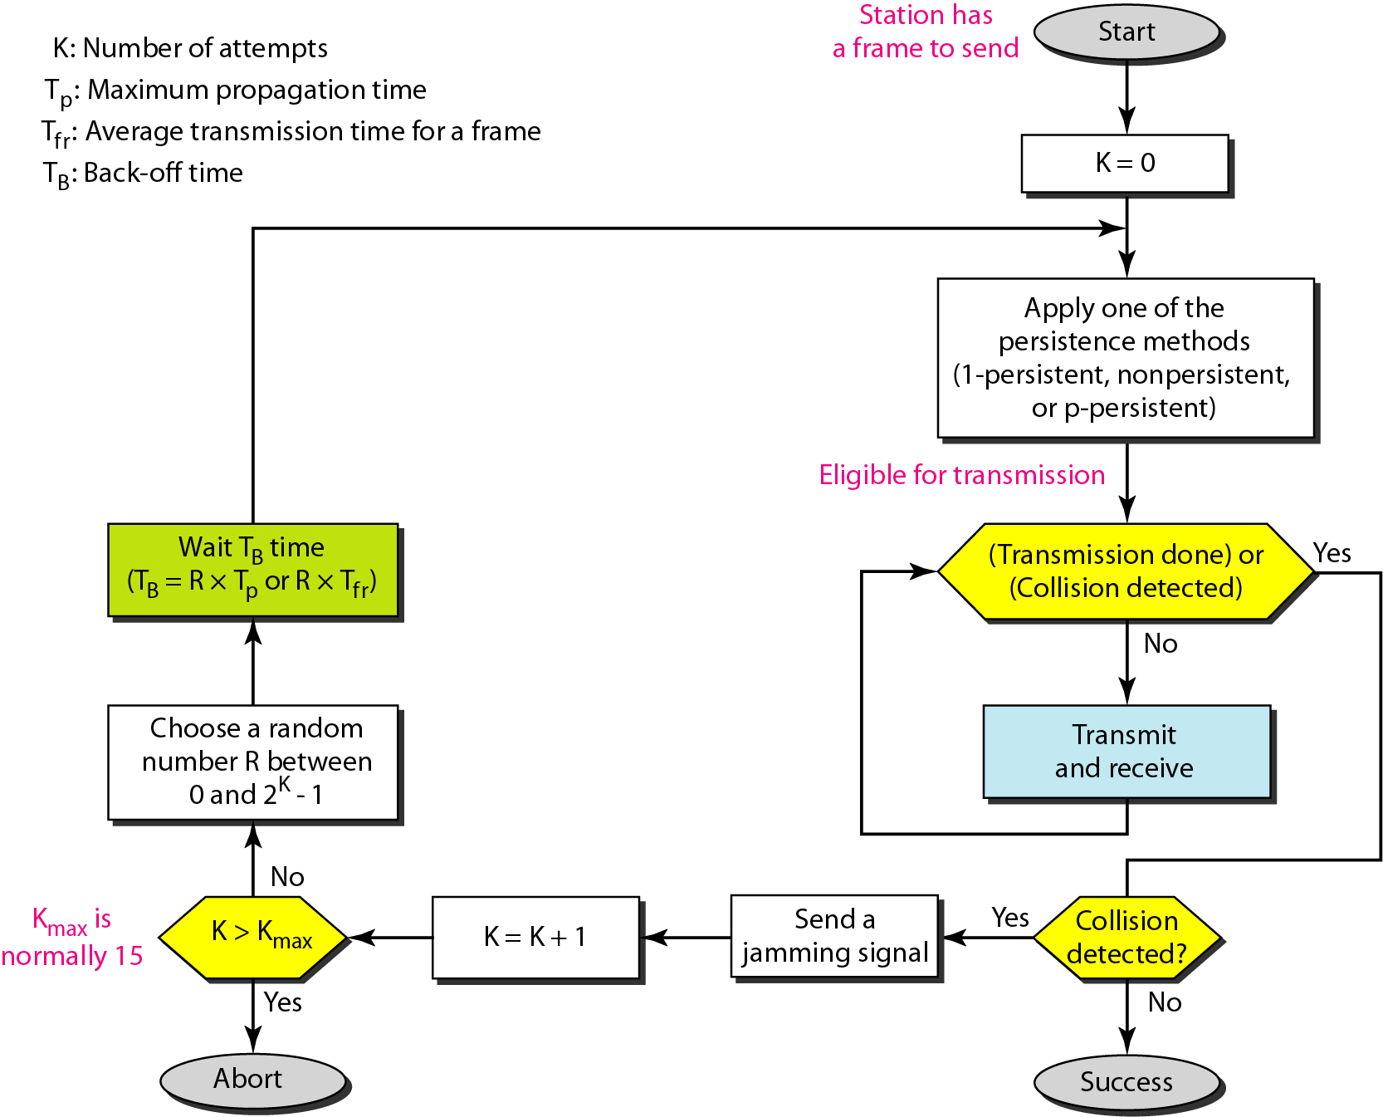
Flow Diagram for the CSMA/CD
B.off= 0
No
Backoff limit?
Backoff ++
Yes
Abort

Slide 67
CSMA/CD Cont…
CSMA/CD supports both baseband and broadband system.
CSMA/CD offers four options in terms of bit rate, signaling method and maximum electrical cable segment length. These are:
10BASE5
10BASE2
10BROAD36
1BASE5
The numeric field in the beginning indicates the bit rate in Mbps, the middle term indicate type of signaling system i.e. baseband or broadband, the numeric field in the end indicates the electrical cable segment length in X 100 meters.

Slide 68
CSMA/CD Throughput
The throughput of CSMA/CD is greater than that of pure or slotted ALOHA.
For 1-persistent method, the maximum throughput is around 50% when G=1.
For non-persistent method, the maximum throughput can go up to 90% when G is between 3 and 8.
G, is offered load rate.

Slide 69
CSMA/CA
Wireless networks cannot use CSMA/CD in the MAC sub layer, since this requires the ability to receive and transmit at the same time- hence the use of CSMA/CA.
Collision are avoided by using three methods.
Inter-frame space
Contention window
Acknowledgments

Slide 70
Inter-frame space (IFS)
Collision are avoided by deferring transmission even if the channel is found idle.
When an idle channel is found, the station does not send immediately. It waits for a period of time called the inter-frame space.
In CSMA/CA, the IFS can also be used to define the priority of a station of a frame.
A station that is assigned shorter IFS has a higher priority.

Slide 71
Contention Window
Contention window are an amount of time divided into slots. A station that is ready to send chooses a random number of slots as its wait time.
Station set one slot for the first time and then double each time the station cannot detect an idle channel after the IFS time.
In this method, the station needs to sense the channel after each time slot.
If the station finds the channel busy, it does not restart the process, it just stops the timer and restarts it when the channel is sensed as idle.
The method gives the priority to the station with the longest waiting time.

Slide 72
Acknowledgments
The data may be corrupted during the transmission.
The positive acknowledgement and the time out can help guarantee that the receiver has received the frame.

Slide 73
Binary Exponential Back-off (BEB) Algorithm
Back-off algorithm is a collision resolution mechanism which is used in random access MAC protocols (CSMA/CD).
This algorithm is generally used in Ethernet to schedule re-transmissions after collisions.
If a collision takes place between 2 stations, they may restart transmission as soon as they can after the collision.
This will always lead to another collision and form an infinite loop of collisions leading to a deadlock.
To prevent such scenario back-off algorithm is used.
BACKOFF MEANS WAITING TIME
BINARY MEANS BETWEEN TWO DEVICE
Let us consider a scenario of 2 stations A and B transmitting some data:

Slide 74
After a collision, time is divided into discrete slots (T_{slot}) whose length is equal to 2t, where t is the maximum propagation delay in the network.
The stations involved in the collision randomly pick an integer from the set K i.e {0, 1}.
This set is called the contention window.
If the sources collide again because they picked the same integer, the contention window size is doubled and it becomes {0, 1, 2, 3}.
Now the sources involved in the second collision randomly pick an integer from the set {0, 1, 2, 3} and wait for that number of time slots before trying again.
Before they try to transmit, they listen to the channel and transmit only if the channel is idle.
This causes the source which picked the smallest integer in the contention window to succeed in transmitting its frame.
So, the Back-off algorithm defines a waiting time for the stations involved in collision,
i.e. for how much time the station should wait to re-transmit.

Slide 75
Waiting time = back–off time
Let n = collision number or re-transmission serial number.
Then, Waiting time = K * T_{slot}
where K = [0, 2^{n} – 1 ]

Slide 76
When both A and B choose K = 0 –> Waiting time for A = 0 * T_{slot} = 0 Waiting time for B = 0 * T_{slot} = 0 Therefore, both stations will transmit at the same time and hence collision occurs.
When A chooses K = 0 and B chooses K = 1 –> Waiting time for A = 0 * T_{slot} = 0 Waiting time for B = 1 * T_{slot} = T_{slot} Therefore, A transmits the packet and B waits for time T_{slot} for transmitting and hence A wins.
When A chooses K = 1 and B chooses K = 0 –> Waiting time for A = 1 * T_{slot} = T_{slot} Waiting time for B = 0 * T_{slot} = 0 Therefore, B transmits the packet and A waits for time T_{slot} for transmitting and hence B wins.
When both A and B choose K = 1 –> Waiting time for A = 1 * T_{slot} = T_{slot} Waiting time for B = 1 * T_{slot} = T_{slot} Therefore, both will wait for the same time T_{slot} and then transmit. Hence, a collision occurs.
Probability that A wins = 1/4
Probability that B wins = 1/4
Probability of collision = 2/4

Slide 77
Case-2: Assume that A wins in Case 1 and transmitted its data(Packet 1).
Now, as soon as B transmits its packet 1, A transmits its packet 2.
Hence, collision occurs. Now collision no. n becomes 1 for packet 2 of A and becomes 2 for packet 1 of B.
For packet 2 of A, K = {0, 1} For packet 1 of B, K = {0, 1, 2, 3}
Probability that A wins = 5/8
Probability that B wins = 1/8
Probability of collision = 2/8
So, the probability of collision decreases as compared to Case 1.

